Slide 1















Financial Management

Slide 2


Congratulations!
Notes:
Firstly, congratulations to each of you for an incredible job well done.

Slide 3

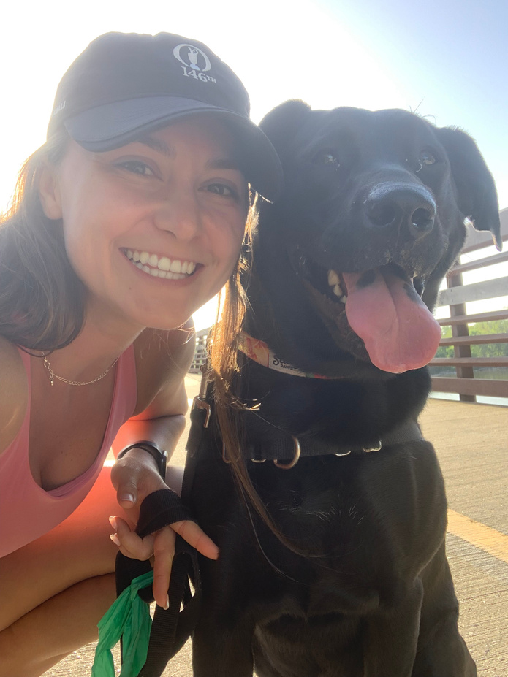


Debt Free
both Colleges
1st Generation
College Student
Masters
Degree
Who Am I
Notes:
Many of you are probably thinking who is this lady and why is she talking to us.

Slide 4
43M
Americans
have student loan debt
Source: Education Data Initiative 2024
Notes:
That number scared the crap out of me when I researched it.
When talking with my feriends about making plans for events we wanted to attend but not having the money to experience them, it may me really question why?
Until I realized, most college grads are still in debt and its effecting their everyday lives.
I’m here to give you tools to stay debt free

Slide 5





Introduction to
Financial Management
SUCCESS OUTSIDE OF ACADEMICS
FUTURE FINANCIAL STABILITY
FINANCIAL FREEDOM

Slide 6

Maslow’s Hierarchy of Needs
need vs. want
Self Actualization
achieving ones full potential
Love + Belonging:
Friendship, sense of connection
feeling of accomplishment
Physiological + Safety:
Food, Water, Security

Slide 7
Maslow’s Hierarchy of Needs
need vs. want
Self Actualization
achieving ones full potential
Love + Belonging:
Friendship, sense of connection
feeling of accomplishment
Physiological + Safety:
Food, Water, Security

Slide 8

SUCCESS OUTSIDE OF ACADEMICS
FINANCIAL FREEDOM
FUTURE FINANCIAL STABILITY
BUDGETING

Slide 9
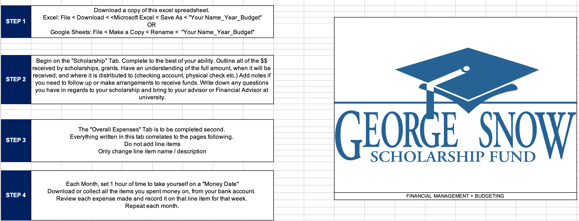
Budget Template
LINK TO SPREADSHEET
HERE

Slide 10
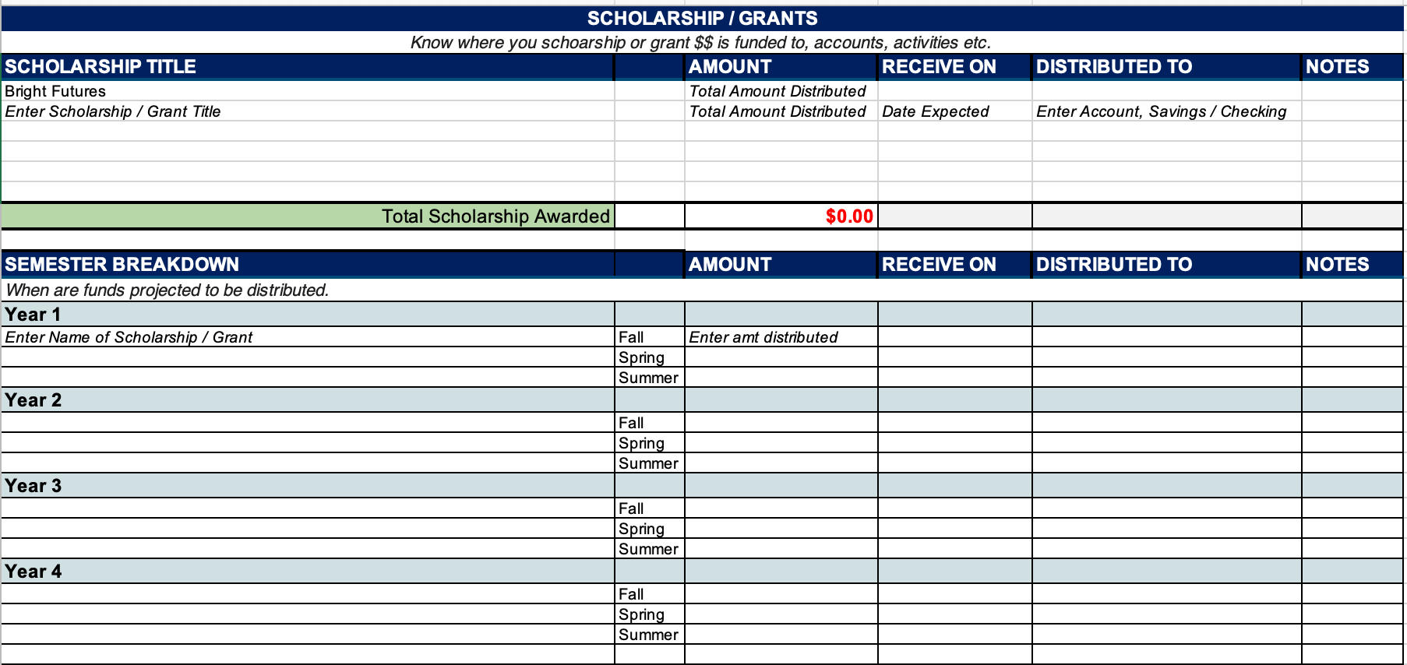
Scholarship Information

Slide 11
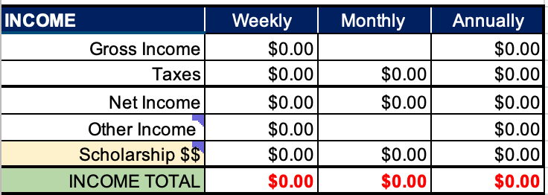

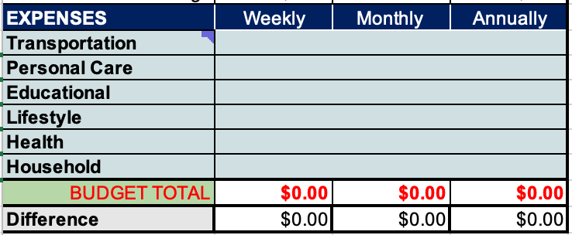
Overall
Expenses
Provides an overview of spending + savings habits, weekly, monthly + annually
  Income: the amount of money you have coming in (scholarship or from job)
  Savings - how much you are putting away for emergencies
  Expenses - what categories are you spending the most money on

Slide 12
Income
Each student will earn Income differently.
Whether scholarship $$’s or you are working a part-time job.
Income from Work: recognize how much is being taken out from taxes
Income from Scholarship = formula based on Scholarship Tab

Slide 13

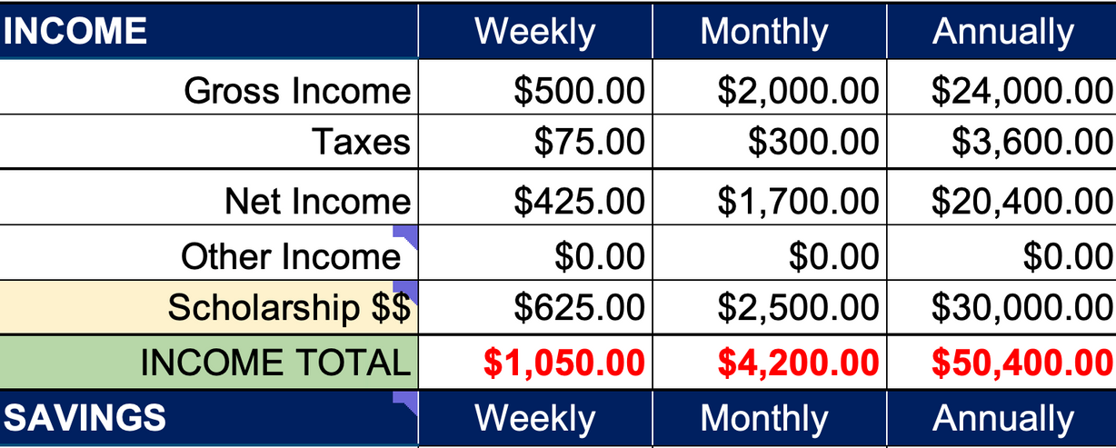
Income
Each student will earn Income differently.
Whether scholarship $$’s or you are working a part-time job.
Income from Work: recognize how much is being taken out from taxes
Income from Scholarship = formula based on Scholarship Tab

Slide 14
Emergencies, Goals + Investments
This line item is important to start tracking to cover any unforeseen costs.
Even if you put just $25 away every pay check, you begin to see this # increase each month.
This serves as an “Emergency Fund”
for things that may be out of your control.

Slide 15
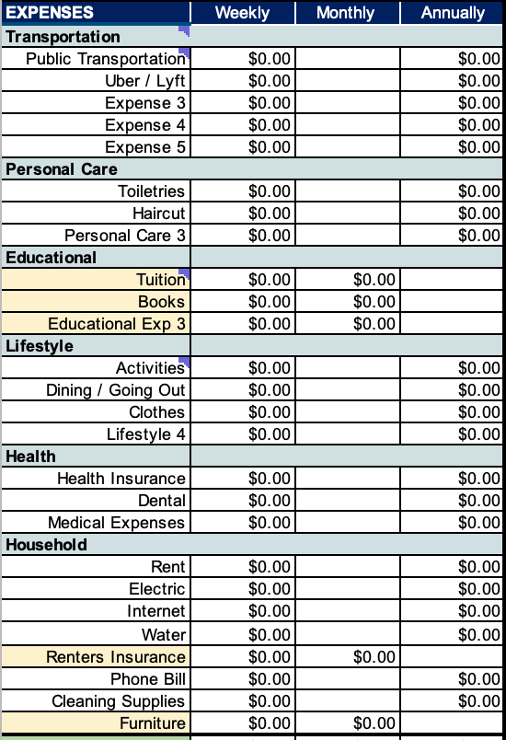
CATEGORY
Expenses
Your expenses are broken out into categories.
For example “Transportation” will be different for each student.
You can change the name of the expenses or the categories but DO NOT add or delete line items. (It will ruin the formula)
Expense
Annual Amount

Slide 16

Budget Total +
Difference
The Budget Total is calculated from adding ALL your expenses
The Difference takes your income amount and subtracts all your expenses.
You DO NOT want the Difference to be negative.

Slide 17
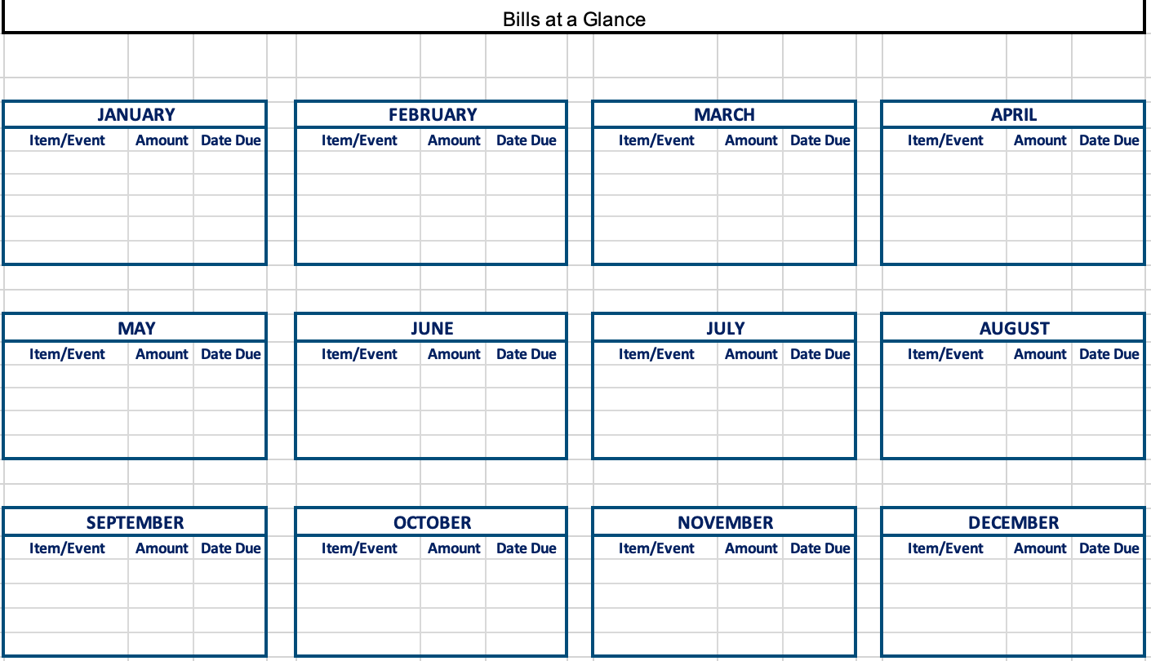
Bills @ at
Glance
This tab is to help you outline what areas of life to plan ahead for. They might not be outlined in your expenses yet, but they could be included in your budget.
It serves as a reminder for expenses you foresee occuring.
Examples:
  Renewals
  Car Registration
  Birthdays
  Anniversaries
  Gifting
  Events

Slide 18
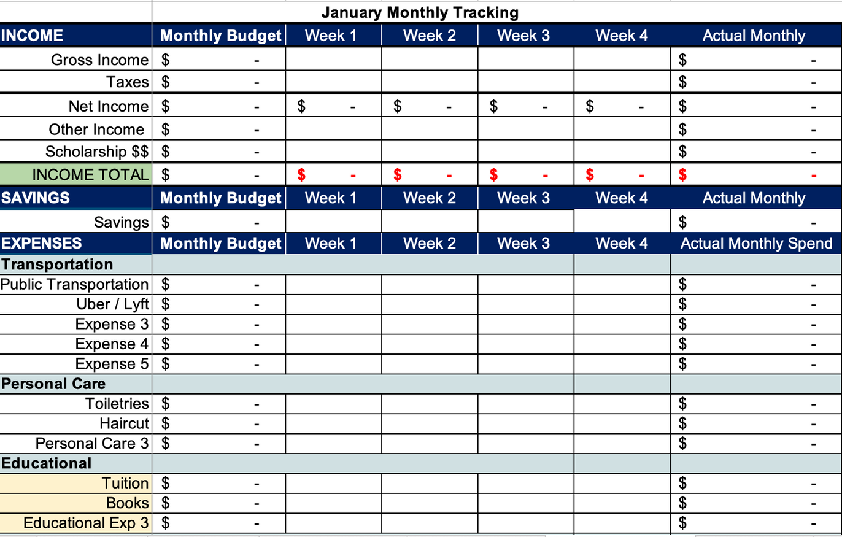
Monthly
Tracking
Each Month, set 1 hour of time to take yourself on a "Money Date"
Download or collect all the assets you spent money on, from your bank account.
Review each expense made and record it on that line item for that week.
Repeat each month.

Slide 19
Step 2:
Complete Scholarship Info
George Snow Scholarship
$15,000
8/31/24
Chase 8831
George Snow Scholarship
$15,000
1/31/25
Chase 8831
$30,000
George Snow Scholarship
$15,000
George Snow Scholarship
$15,000

Slide 20
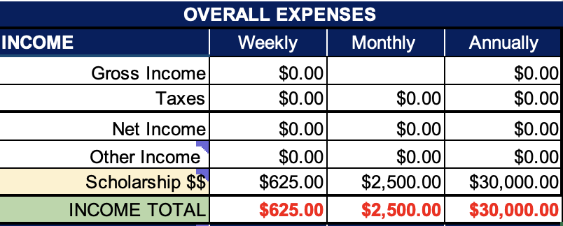
Step 3:
Complete Overall Expense Tab
Notes:
Your scholarship $$ will automatically populate. Important to do that step first

Slide 21
Step 3:
Complete Overall Expense Tab
Notes:
If you don’t have any additional income, you aren’t working a job or have any other areas where money is coming into your bank account. You have $30,000 to get you through the year.

Slide 22
Step 3:
Complete Overall Expense Tab
$2,000
$24,000
15%
$1,700
$20,400
$4,200
$50,400
Notes:
If you do have additional income, say you are working a job that pays you $2,000 a month.
2,000 x 24 = 24,000 annyally in income
Most companies you work for will take taxes out, lets say on average 15%
You are left with $1,700 monthly and $20,400 annually
Yes its frustrating to see this amount of money being taken out but youll learn about taxes hopefully in your economics + accounting classes in college!
Nowm wth the addition of your scholarship money you have a great lump sum of income

Slide 23
Step 3:
Complete Overall Expense Tab
$5
$30
$25
$60
$10,000
Annual Amount
$300
Gym / Workout Class
$100
Notes:
Go through each line item and add in what you believe you spend monthly on each one

Slide 24
Step 3:
Complete Overall Expense Tab
$270
$1,078
$12,940
$355
$1,422
$17,060
Don’t let these numbers become negative
Notes:
Go through each line item and add in what you believe you spend monthly on each one

Slide 25
Step 4:
Monthly Tracking
These numbers will populate once you complete step 3!
Each Month, set 1 hour of time to take yourself on a "Money Date"
Download or collect all the assets you spent money on, from your bank account.
Review each expense made and record it on that line item for that week.
Repeat each month.

Slide 26
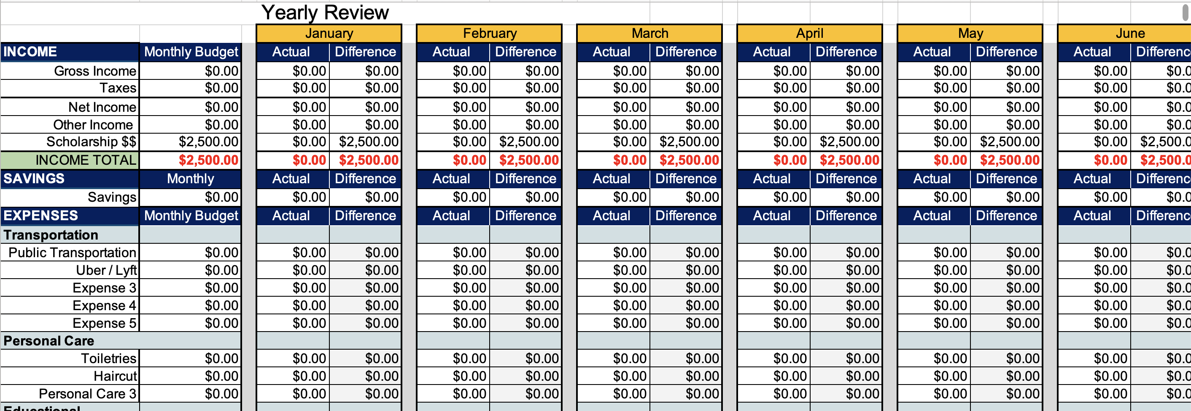
Final Step:
Annual Review
At the end of the year, you will have an entire snapshot of how much money came in, how much you saved, where you spent the most money and if you need to adjust your budget for the next year.

Slide 27
Responsible saving + consumption strategies
Set “Money Dates”
Avoid impulse purchases
Carpool / Public Transport.
Monthly dates with yourself to review your spending habits and fill in your Expense Sheet!
Ask yourself is this a need or a want. Am I willing to sacrifice something else to purchase this?
Find ways to be creative to save money on transportation; carpool with friends, bike / walk to class
Buy Used Textbooks
Cook / Meal Prep @ Home
Free Campus Events
Don’t buy the first book you need; research, ask, Facebook marketplace is your bestie!
Typically, cheaper than eating out + utilizes fewer ingredients across different meals.
Take advantage of events on campus; free meals / activities
Join free clubs to be involved!

Slide 28




Have Fun
Capture Memories
Make New friends
Celebrate the Wins
Respect the Losses
Enjoy every moment

Slide 29



Questions?

